Slide 2
Signs of a One-World Government Coming
Is a world Dictator about to Appear?

Slide 3
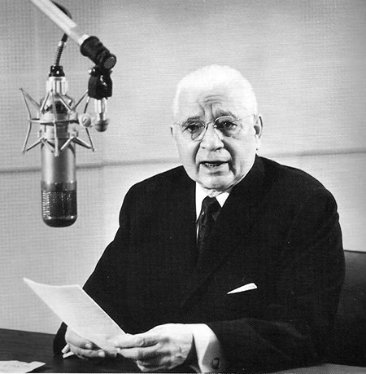
Herbert W. Armstrong
Old Time Radio Catalog

Slide 4
Herbert W Armstrong
We live today in the most strenuous, anxious,
momentous hours of earth’s history. Today we stand on the very threshold of colossal events that will stagger the mind of mortal man. Just now it is like the lull before a great and devastation storm. Everyone senses it!
Old Time Radio Catalog

Slide 5
Herbert W Armstrong
The Lust for World Power
Ever since the Pharaohs ruled I Egypt---on down thru ancient Assyria, Babylon, Persia, Greece, and Rome---on to Napoleon, and then the Kaiser---there has been a lust for power to rule the world. Today at least three major world powers seek to rule the world.
Old Time Radio Catalog

Slide 6
Herbert W Armstrong
What is Going to Happen?
Will some super-man now emerge? Will the nations get together and appoint a world dictator? Mortal man cannot prophesy the turns and trends of coming events. Only God knows the end from the beginning.
Old Time Radio Catalog

Slide 7
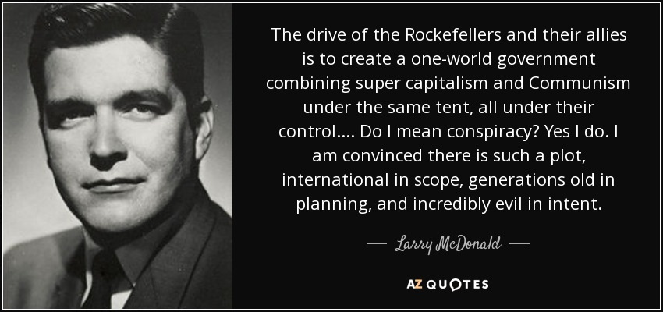

Slide 8
Lawrence Patton McDonald, M.D. (April 1, 1935 – September 1, 1983) was an American politician and a member of the United States House of Representatives, representing the seventh congressional district of Georgia as a Democrat. He was a passenger on board Korean Air Lines Flight 007 when it was shot down by Soviet interceptors and presumed dead. He was known for his staunch opposition to communism and believed in long standing covert efforts by Trilateral Commission and other powerful US groups to bring about a socialism and world government. He was also a cousin of General George S. Patton. "While the [U.S.] government has made no such charge, McDonald's widow claims that her husband, the national chairman of the John Birch Society, was 'murdered.' She holds that it was no accident that 'the leading anti-Communist in the American government' had been on a plane that was 'forced into Soviet territory' and shot down."
(Brussell, M. 2014) The Essential Mae Brussell: Investigations of Fascism in America

Slide 9
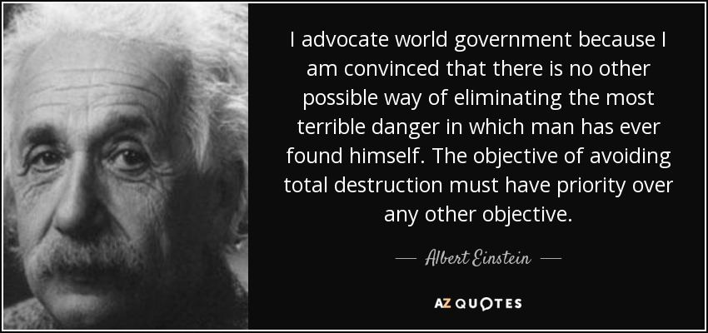

Slide 10
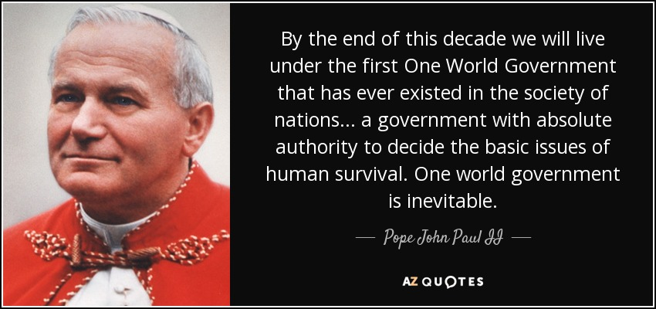

Slide 11
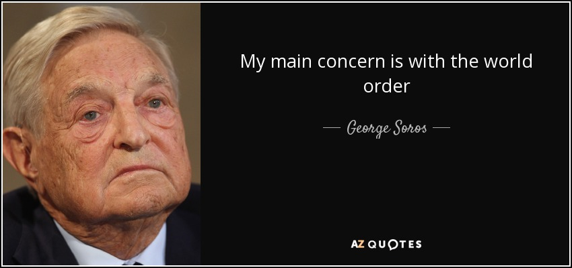

Slide 12
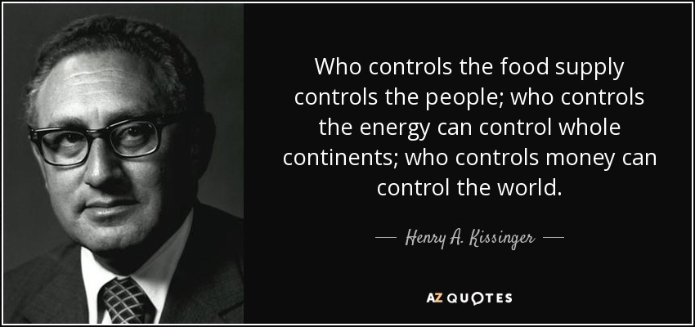

Slide 14
Feb 10 2019
Deputy Secretary-General's address to the World Government Summit
“We must all keep pushing the boundaries of transformation.
The ambition of the 2030 Agenda provides a roadmap for mobilizing every segment of society as well as public, private, domestic and international resources.”
Amina J. Mohammed
https://www.un.org/sg/en/content/dsg/statement/2019-02-10

Slide 15
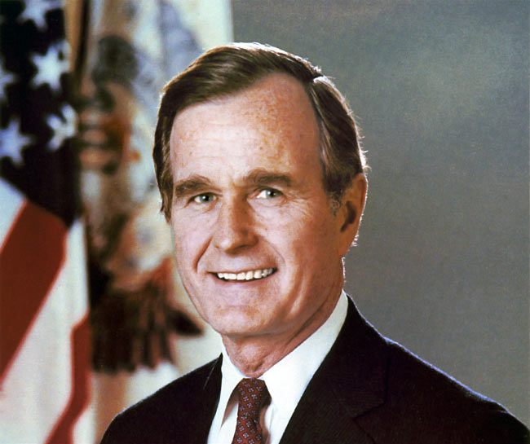
“We have before us the opportunity to forge for ourselves and for future generations a new world order, a world where the rule of law, not the rule of the jungle, governs the conduct of nations.
When we are successful, and we will be, we have a real chance at this new world order, and order in which a credible United Nations can use its peacekeeping role to fulfill the promise and vision fo the U.N.’s founders.”
President George Bush (Sr.), In a nationwide United States television speech July 17th 1991
www.wakeupkiwi.com

Slide 16
https://clintonwhitehouse2.archives.gov/PCSD/

Slide 17
From constitutionparty.com:
“Agenda 21 is a comprehensive plan of utopian environmentalism, social engineering, and global political control that was initiated at the United Nations Conference on Environmental and Development (UNCED) held in Rio de Janeiro, Brazil, in 1992.
Agenda 21 policy is being covertly advanced in local communities across the nation through the efforts of the International Council of Local Environmental Initiatives (ICLEI) in cooperation with state and municipal elected officials and bureaucrats via local “sustainable development” policies such as Smart Growth, Wildlands Project, Resilient Cities, Regional Visioning Projects, and other “Green” or “Alternative” projects.

Slide 18
17 Sustainable Development Goals (SDGs)
No Poverty
Zero hunger
Good health and wellbeing
Quality education
Gender equality
Clean water & sanitation
Affordable & clean energy
Decent work & economic growth
Industry, innovation & infrastructure
Reduced inequalities
Sustainable cities & communities
Responsible consumption & production
Climate action
Life below water
Life on land
Peace, justice & strong institutions
Partnerships
sustainabledevelopment.un.org

Slide 19
5 things you need to know about the 2030 Agenda for Sustainable Development
The 2030 Agenda applies to all countries and actors . . . (Universal)
The SDGs are interlinked . . . (integrated)
Leaving No One Behind.
Development must be smart-if it’s not risk-informed, it’s not sustainable.
Everyone is needed! . . . (The multi-stakeholder approach)
UN Development Programme (medium.com)

Slide 20
Agenda 21 by Ron Taylor
”To achieve one world government, the UN needs three powers:
An international Tax
Judicial powers
A standing army”

Slide 21
2010 Cancun Climate Summit
The 2010 Cancun Climate Summit (and those following) give the UN the authority to impose “carbon taxes” on prosperous nations.

Slide 22
ICC
The International Criminal Court was established in 2002 based in The Hague, Netherlands. The UN has blue helmeted soldiers, volunteers from member states, in various places around the globe. . .
https://www.icc-cpi.int

Slide 23
Pope Francis: World Government Must Rule U.S. ‘For Their Own Good’
Pope Francis told the Italian newspaper La Repubblica that the United States of America has “ a distorted vision of the world” and Americans must be ruled by a world government, as soon as possible, “for their own good.”
In the same interview, according to La Repubblica, Pope Francis said that Europe must take on a “federal structure,” resembling feudal times when the peasants were ruled by unimpeachable monarchs
www.Yournewswire.com Baxter Dmitry July 9, 2017

Slide 24
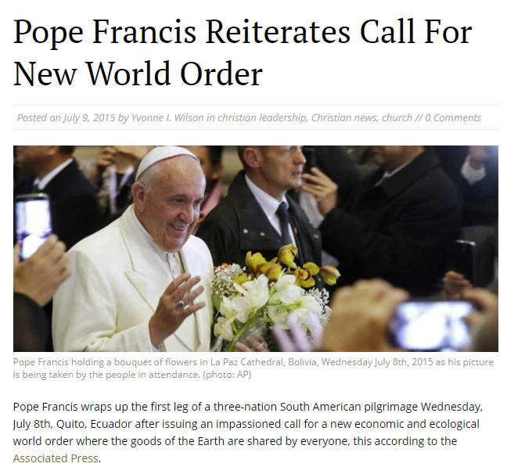
La Paz Cathedral, Bolivia, Wednesday July 8th, 2015, picture is being taken by the people in attendance, (photo: Associated Press )

Slide 25
Pope Francis
June 2015: Pope Francis called for “a new global political authority” that would have the resources necessary “to deal with the world’s economic problems and injustices”.
www.Yournewswire.com Baxter Dmitry July 9, 2017

Slide 26
Pope Francis
July 2016, Pope Francis told hundreds of thousands of young people gathered for World Youth Day in Poland that they need to “believe in a new humanity” and that they should refuse “to see borders as barriers”.
www.Yournewswire.com Baxter Dmitry July 9, 2017

Slide 27
Pope Francis
June 2017, The Pope has argued that the creation of the one world government is needed to combat major issues such as “climate change.”
www.Yournewswire.com Baxter Dmitry July 9, 2017

Slide 28
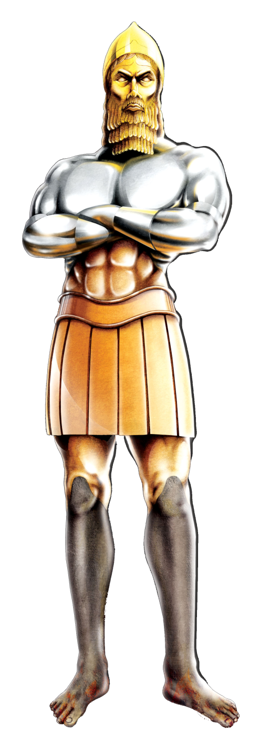
Daniel 2:31-33
(31) "You, O king, were watching; and behold, a great image! This great image, whose splendor was excellent, stood before you; and its form was awesome. (32) This image's head was of fine gold, its chest and arms of silver, its belly and thighs of bronze, (33) its legs of iron, its feet partly of iron and partly of clay.
The Middle East in Bible Prophecy-(UCG)

Slide 29
Daniel 2: (34) You watched while a stone was cut out without hands, which struck the image on its feet of iron and clay, and broke them in pieces. (35) Then the iron, the clay, the bronze, the silver, and the gold were crushed together, and became like chaff from the summer threshing floors; the wind carried them away so that no trace of them was found. And the stone that struck the image became a great mountain and filled the whole earth.
Artist: Steve Creitz, Daniel 2 Statue With Stone, www.goodsalt.com

Slide 30
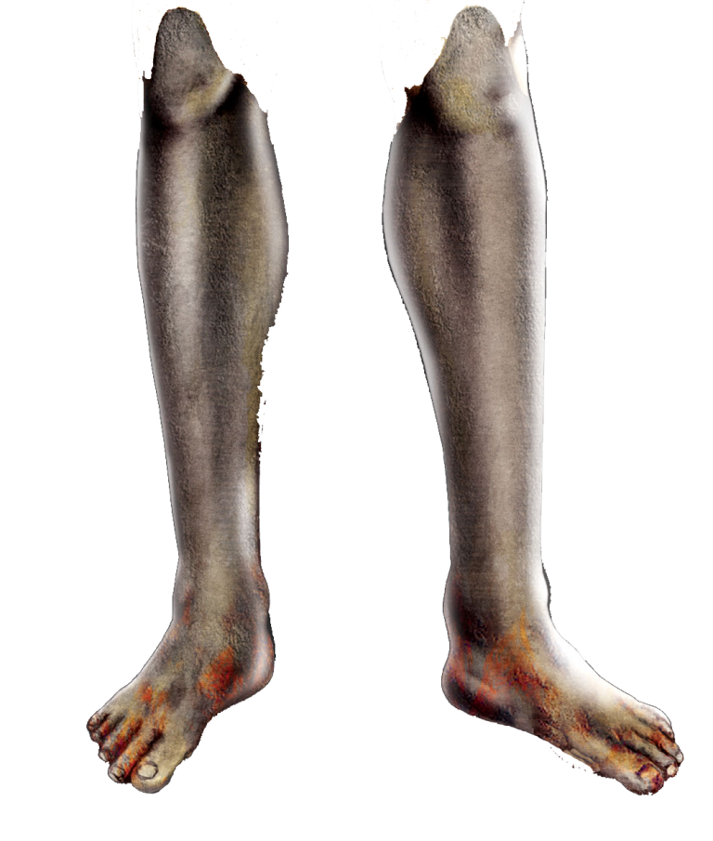
Daniel 2:40-42
(40) And the fourth kingdom shall be as strong as iron, inasmuch as iron breaks in pieces and shatters everything; and like iron that crushes, that kingdom will break in pieces and crush all the others. (41) Whereas you saw the feet and toes, partly of potter's clay and partly of iron, the kingdom shall be divided; yet the strength of the iron shall be in it, just as you saw the iron mixed with ceramic clay. (42) And as the toes of the feet were partly of iron and partly of clay, so the kingdom shall be partly strong and partly fragile.
The Middle East in Bible Prophecy-(UCG)

Slide 31
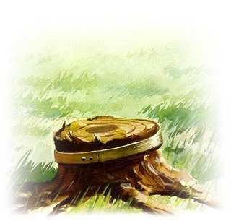
Daniel 4:14-15
(14) He cried aloud and said thus: 'Chop down the tree and cut off its branches, Strip off its leaves and scatter its fruit. Let the beasts get out from under it, And the birds from its branches. (15) Nevertheless leave the stump and roots in the earth, Bound with a band of iron and bronze, . . .
moringtonpeninsulasda.org

Slide 32
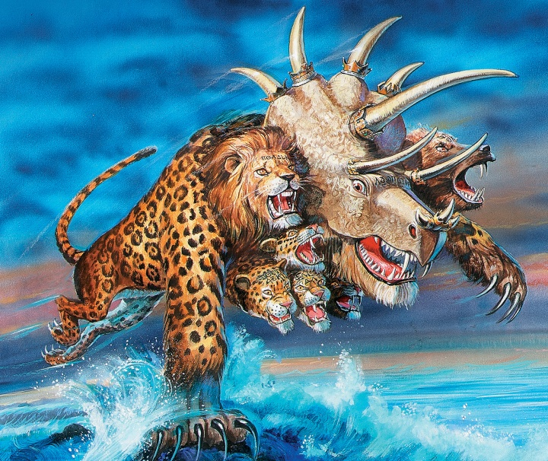
Revelation 13:1-3
The Book of Revelation Unveiled-(UCG)
(1) Then I stood on the sand of the sea. And I saw a beast rising up out of the sea, having seven heads and ten horns, and on his horns ten crowns, and on his heads a blasphemous name. (2) Now the beast
which I saw was like a leopard, his feet were
like the feet of a bear, and his mouth like
the mouth of a lion. The dragon gave him
his power, his throne, and great authority.
(3) And I saw one of his heads as if it had
been mortally wounded, and his deadly
wound was healed. And all the world
marveled and followed the beast.

Slide 33
”SEA” occurs 24 times in Revelation. Most references are literally the ocean, but some refer to mankind:
Rev 13:1 Then I stood on the sand of the sea. And I saw a beast rising up out of the sea, having seven heads and ten horns, and on his horns ten crowns, and on his heads a blasphemous name.
Rev 17:15 Then he said to me, "The waters which you saw, where the harlot sits, are peoples, multitudes, nations, and tongues.

Slide 34
Revelation 17:11-14
(11) The beast that was, and is not, is himself also the eighth, and is of the seven, and is going to perdition. (12) "The ten horns which you saw are ten kings who have received no kingdom as yet, but they receive authority for one hour as kings with the beast. (13) These are of one mind, and they will give their power and authority to the beast. (14) These will make war with the Lamb, and the Lamb will overcome them, for He is Lord of lords and King of kings; and those who are with Him are called, chosen, and faithful."

Slide 35
Counterfeit Kingdom established
Revelation 13:4-6
(4) So they worshiped the dragon who gave authority to the beast; and they worshiped the beast, saying, "Who is like the beast? Who is able to make war with him?" (5) And he was given a mouth speaking great things and blasphemies, and he was given authority to continue for forty-two months. (6) Then he opened his mouth in blasphemy against God, to blaspheme His name, His tabernacle, and those who dwell in heaven.

Slide 36
Civil Power unites all the earth, Beast worship begins
Revelation 13:7-9
(7) It was granted to him to make war with the saints and to overcome them. And authority was given him over every tribe, tongue, and nation. (8) All who dwell on the earth will worship him, whose names have not been written in the Book of Life of the Lamb slain from the foundation of the world. (9) If anyone has an ear, let him hear.

Slide 37
RELIGIOUS LEADER WIELDS POWER
Revelation 13:11-14
(11) Then I saw another beast coming up out of the earth, and he had two horns like a lamb and spoke like a dragon. (12) And he exercises all the authority of the first beast in his presence, and causes the earth and those who dwell in it to worship the first beast, whose deadly wound was healed. (13) He performs great signs, so that he even makes fire come down from heaven on the earth in the sight of men. (14) And he deceives those who dwell on the earth—by those signs which he was granted to do in the sight of the beast, telling those who dwell on the earth to make an image to the beast who was wounded by the sword and lived.

Slide 38
Counterfeit Kingdom established
Revelation 13:15-17
(15) He was granted power to give breath to the image of the beast, that the image of the beast should both speak and cause as many as would not worship the image of the beast to be killed. (16) He causes all, both small and great, rich and poor, free and slave, to receive a mark on their right hand or on their foreheads, (17) and that no one may buy or sell except one who has the mark or the name of the beast, or the number of his name.

Slide 39
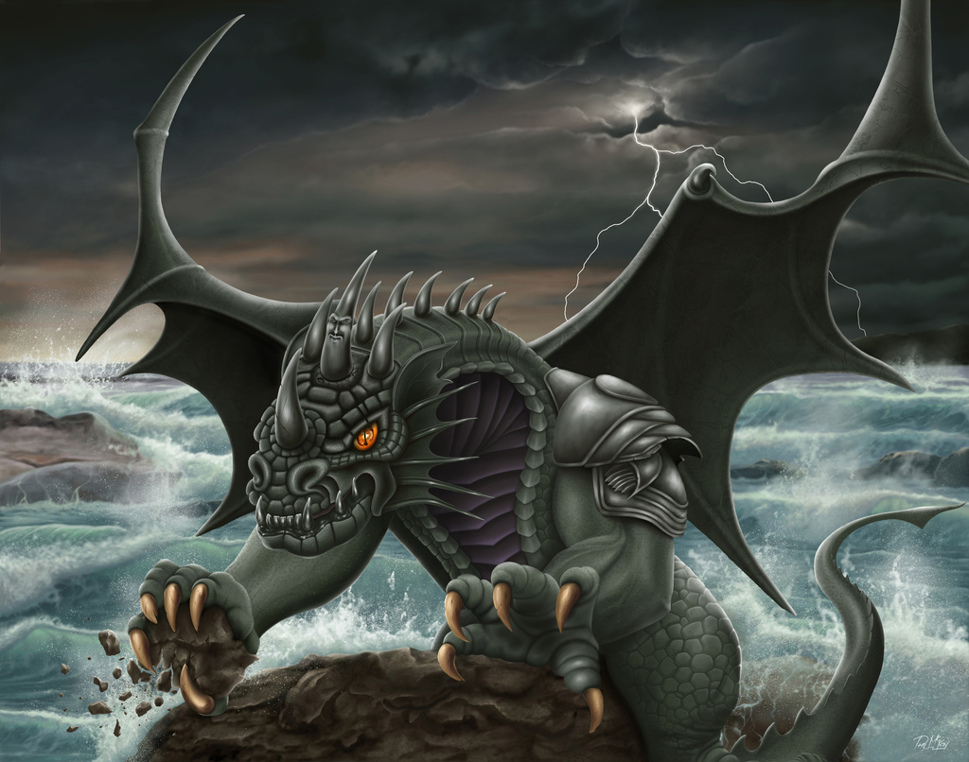
Daniel 7:7-8
(7) "After this I saw in the night visions, and behold, a fourth beast, dreadful and terrible, exceedingly strong. It had huge iron teeth; it was devouring, breaking in pieces, and trampling the residue with its feet. It was different from all the beasts that were before it, and it had ten horns.
Artist: Phil McKay, Fourth Beast of Daniel 7, www.goodsalt.com

Slide 40
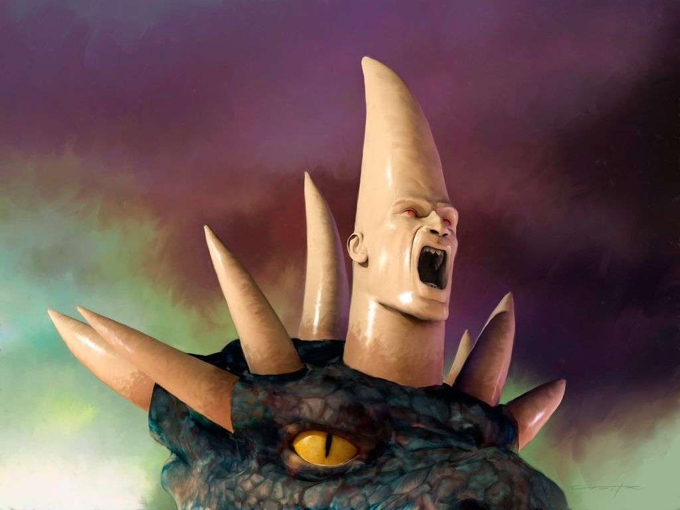
Daniel 7:7-8
(8) I was considering the horns, and there was another horn, a little one, coming up among them, before whom three of the first horns were plucked out by the roots. And there, in this horn, were eyes like the eyes of a man, and a mouth speaking pompous words.
Artist: Steve Creitz, Little Horn From Daniel 7, www.goodsalt.com

Slide 41
Daniel 7:9-11
(9) "I watched till thrones were put in place, And the Ancient of Days was seated; His garment was white as snow, And the hair of His head was like pure wool. His throne was a fiery flame, Its wheels a burning fire; (10) A fiery stream issued And came forth from before Him. A thousand thousands ministered to Him; Ten thousand times ten thousand stood before Him. The court was seated, And the books were opened. (11) "I watched then because of the sound of the pompous words which the horn was speaking; I watched till the beast was slain, and its body destroyed and given to the burning flame.

Slide 42
Counterfeit Kingdom established—man of sin
2 Thessalonians 2:3-4
(3) Let no one deceive you by any means; for that Day will not come unless the falling away comes first, and the man of sin is revealed, the son of perdition, (4) who opposes and exalts himself above all that is called God or that is worshiped, so that he sits as God in the temple of God, showing himself that he is God.

Slide 43
Counterfeit Kingdom established—man of sin
2 Thessalonians 2:8-9
(8) And then the lawless one will be revealed, whom the Lord will consume with the breath of His mouth and destroy with the brightness of His coming. (9) The coming of the lawless one is according to the working of Satan, with all power, signs, and lying wonders,

Slide 44
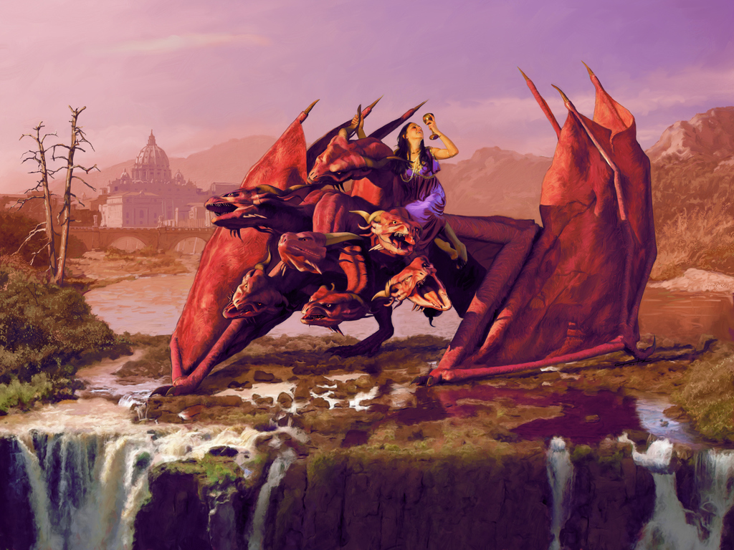
Counterfeit Kingdom established
Revelation 17:1-3
(1) Then one of the seven angels who had the seven bowls came and talked with me, saying to me, "Come, I will show you the judgment of the great harlot who sits on many waters, (2) with whom the kings of the earth committed fornication, and the inhabitants of the earth were made drunk with the wine of her fornication."
(3) So he carried me away in the Spirit into the wilderness. And I saw a woman sitting on a scarlet beast which was full of names of blasphemy, having seven heads and ten horns.
Artist: Steve Creitz, WhoreBeast, www.goodsalt.com

Slide 45
Counterfeit Kingdom established
Revelation 17:4-6
(4) The woman was arrayed in purple and scarlet, and adorned with gold and precious stones and pearls, having in her hand a golden cup full of abominations and the filthiness of her fornication. (5) And on her forehead a name was written: MYSTERY, BABYLON THE GREAT, THE MOTHER OF HARLOTS AND OF THE ABOMINATIONS OF THE EARTH. (6) I saw the woman, drunk with the blood of the saints and with the blood of the martyrs of Jesus. And when I saw her, I marveled with great amazement.
Artist: Steve Creitz, WhoreBeast, www.goodsalt.com

Slide 46
Counterfeit Kingdom established
Revelation 17:7-8
(7) But the angel said to me, "Why did you marvel? I will tell you the mystery of the woman and of the beast that carries her, which has the seven heads and the ten horns. (8) The beast that you saw was, and is not, and will ascend out of the bottomless pit and go to perdition. And those who dwell on the earth will marvel, whose names are not written in the Book of Life from the foundation of the world, when they see the beast that was, and is not, and yet is.

Slide 47
Counterfeit Kingdom established
Revelation 17:9-12
(9) And here is the mind which has wisdom. The seven heads are seven mountains, on which the woman sits. (10) And there are seven kings; five have fallen, and one is, and the other has not yet come. And when he comes, he must continue a short time. (11) And the beast that was, and is not, even he is the eighth, and is of the seven, and goes into perdition. (12) And the ten horns which you saw are ten kings, who have received no kingdom yet, but will receive authority as kings one hour with the beast.

Slide 48
Counterfeit Kingdom established
Revelation 17:13-18
(13) These have one mind, and they will give their power and authority to the beast. (14) These will make war with the Lamb, and the Lamb will overcome them. For He is Lord of lords and King of kings. And those with Him are the called and elect and faithful ones. (15) And he says to me, The waters which you saw, where the harlot sits are peoples and multitudes and nations and tongues, . . .

Slide 49
Counterfeit Kingdom established
Revelation 17:13-18 (cont.)
(16) and the ten horns which you saw on the beast, these will hate the harlot and will make her desolate and naked. And they will eat her flesh and burn her with fire. (17) For God gave into their hearts to do His mind, and to act with one mind, and to give their kingdom to the beast until the Words of God will be fulfilled. (18) And the woman whom you saw is the great city which has a kingdom over the kings of the earth.

Slide 50
Punishment of second babylon
Revelation 18:1-3
(1) And after these things I saw another angel come down from Heaven, having great authority. And the earth was lighted up from his glory. (2) And he cried mightily with a strong voice, saying, Babylon the great has fallen, has fallen! And it has become the dwelling-place of demons, and a prison of every unclean spirit, and a cage of every unclean bird which has been hated, (3) because of the wine of the anger of her fornication which all the nations have drunk. And the kings of the earth have committed fornication with her. And the merchants of the earth became rich from the power of her luxury.

Slide 51
Punishment of second babylon
Revelation 18:6-9
(6) Reward her as she has rewarded you, and double to her double, according to her works. In the cup which she mixed, mix double to her. (7) As much as she has glorified herself and has lived in luxury, so much torment and sorrow give her. For she says in her heart, I sit as a queen, and I am not a widow; and I do not see mourning at all. . . .

Slide 52
Punishment of second babylon
Revelation 18:6-9 (cont. )
(8) Therefore her plagues will come in one day, death and mourning and famine. And she will be consumed with fire, for the Lord God who judges her is strong. (9) And the kings of the earth who have committed fornication and lived in luxury with her will weep for her, and will wail over her when they see the smoke of her burning;

Slide 53
Punishment of second babylon
Revelation 18:24
And in her was found the blood of prophets, and of saints, and of all those who were slain on the earth.
HOW MUCH BLOOD IS REQUIRED?

Slide 54
Punishment of second Babylon
Luke 11:49-51
(49) Therefore the wisdom of God also said, I will send them prophets and apostles, and some of them they shall slay and persecute, (50) so that the blood of all the prophets, which was shed from the foundation of the world, may be required of this generation; (51) from the blood of Abel to the blood of Zechariah, who perished between the altar and the temple. Truly I say to you, It shall be required of this generation.

Slide 55
Punishment of second Babylon
Who Was Zecharias?
What was his message from God?
About 760 BC

Slide 56
Punishment of second Babylon
2 Chronicles 24:20-21
(20) Then the Spirit of God came upon Zechariah the son of Jehoiada the priest, who stood above the people, and said to them, "Thus says God: 'Why do you transgress the commandments of the LORD, so that you cannot prosper? Because you have forsaken the LORD, He also has forsaken you.' " (21) So they conspired against him, and at the command of the king they stoned him with stones in the court of the house of the LORD.
Josephus records 1.1 million deaths in the 70 AD Judaic war

Slide 57
Punishment of second Babylon—Unrequited blood
IF From Creation to 760 BC the total was 1.1 million followers of God killed for their beliefs, what is the number from 760 BC until the return of Jesus the Messiah?

Slide 58
Punishment of second Babylon—Unrequited blood
Revelation 14:19-20
(19) So the angel thrust his sickle into the earth and gathered the vine of the earth, and threw it into the great winepress of the wrath of God. (20) And the winepress was trampled outside the city, and blood came out of the winepress, up to the horses' bridles, for one thousand six hundred furlongs.

Slide 59
Punishment of second Babylon—Unrequited blood
Revelation 19:15
Now out of His mouth goes a sharp sword, that with it He should strike the nations. And He Himself will rule them with a rod of iron. He Himself treads the winepress of the fierceness and wrath of Almighty God.

Slide 60
Purpose of the persecution of the church
Daniel 11:32-35
(32) Those who do wickedly against the covenant he shall corrupt with flattery; but the people who know their God shall be strong, and carry out great exploits. (33) And those of the people who understand shall instruct many; yet for many days they shall fall by sword and flame, by captivity and plundering. (34) Now when they fall, they shall be aided with a little help; but many shall join with them by intrigue. (35) And some of those of understanding shall fall, to refine them, purify them, and make them white, until the time of the end; because it is still for the appointed time.

Slide 61
Purpose of the persecution of the church
Revelation 18:4-5
(4) And I heard another voice from heaven saying, "Come out of her, my people, lest you share in her sins, and lest you receive of her plagues. (5) For her sins have reached to heaven, and God has remembered her iniquities.

Slide 62
Purpose of the persecution of the church
2 Corinthians 6:16-17
(16) And what agreement has the temple of God with idols? For you are the temple of the living God. As God has said: "I WILL DWELL IN THEM AND WALK AMONG THEM. I WILL BE THEIR GOD, AND THEY SHALL BE MY PEOPLE." (17) Therefore "COME OUT FROM AMONG THEM AND BE SEPARATE, SAYS THE LORD. DO NOT TOUCH WHAT IS UNCLEAN, AND I WILL RECEIVE YOU."

