Slide 1
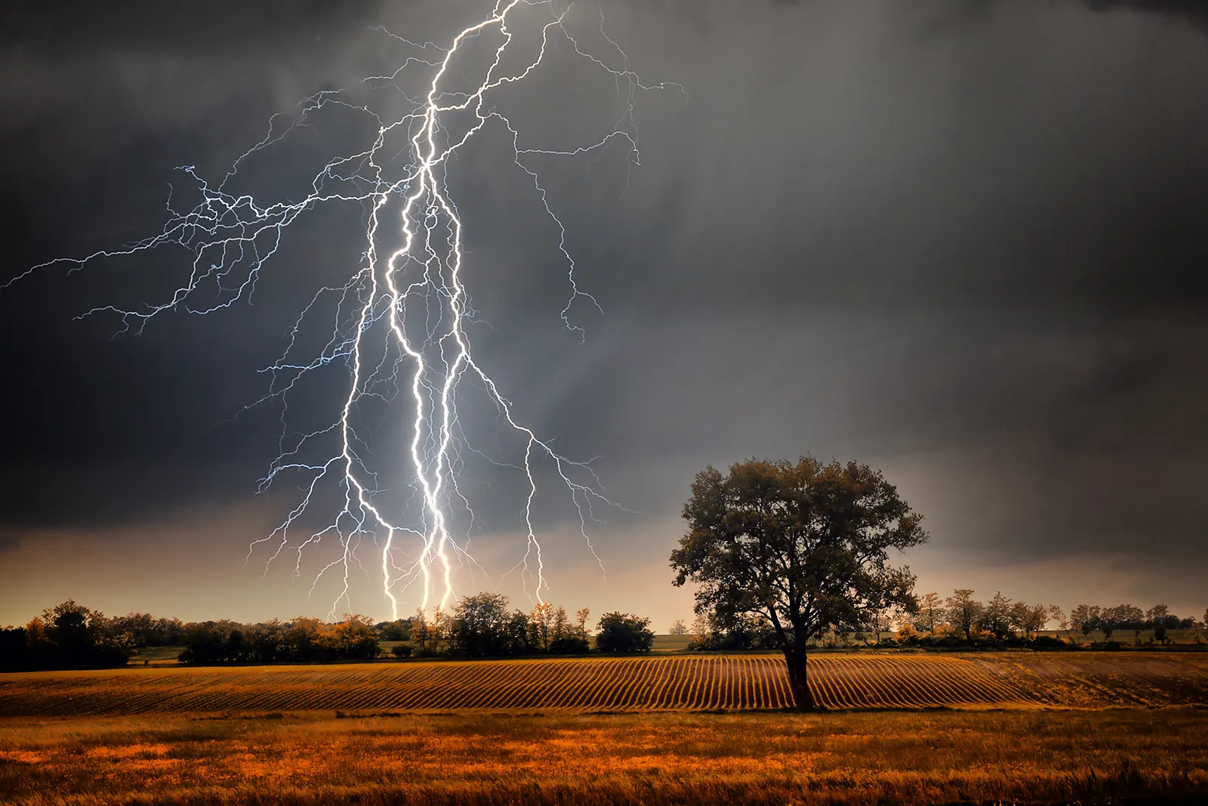
Long ODDs
Getting hit by Lightning
1 in 1,000,000

Slide 2
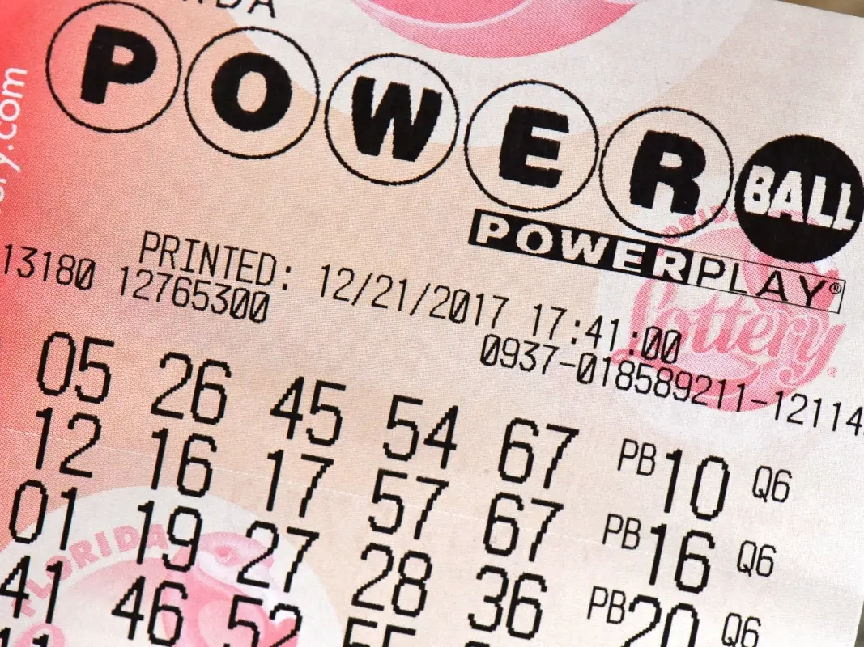
Long ODDs
Winning the Lottery (Powerball)
1 in 292,000,000
(worse if no ticket)

Slide 3
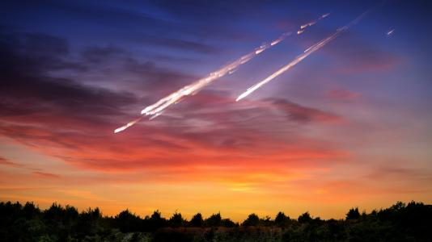
Long ODDs
Meteorite landing in Backyard
1 in 20,000,000,000,000

Slide 4
8
Fulfilled Prophecies
about Messiah
1 in
100,000,000,000,000,000
1 followed by 17 zeros

Slide 5
GOD did it:
100,000,000,000,000,000
1 followed by 17 zeros
Chance, Satan, or Anyone but God:
1

Slide 6
16
Fulfilled Prophecies
about Messiah
1 in
1,000,000,000,000,000,000,000,000,000,000,000,000,000,000,000
1 followed by 45 zeros

Slide 7
48
Fulfilled Prophecies
about Messiah
1 in
10,000,000,000,000,000,000,000,000,000,000,000,000,000,000,000,000,000,000,000,000,000,000,000,000,000,000,000,000,000,000,000,000,000,000,000,000,000,000,000,000,000,000,000,000,000,000,000,000,000,000,000,000
1 followed by 157 zeros

